Slide 1
Machine Learning
Machine Learning Introduction to Machine Learning by Kumar Anurupam is licensed under a Creative Commons Attribution-4.0 International License.
Artificial Neural Networks – Revisiting NN History, Simple Neuron, BNN growth
CS 3104 Fall 2019
Lecture Slides by Kumar Anurupam

Slide 2
Learning Objectives
After completion of today’s session you will be able to:
Elaborate the history of ANN
Explain a Simple Neuron
Analyze the growth of Biological Neural Networks

Slide 3
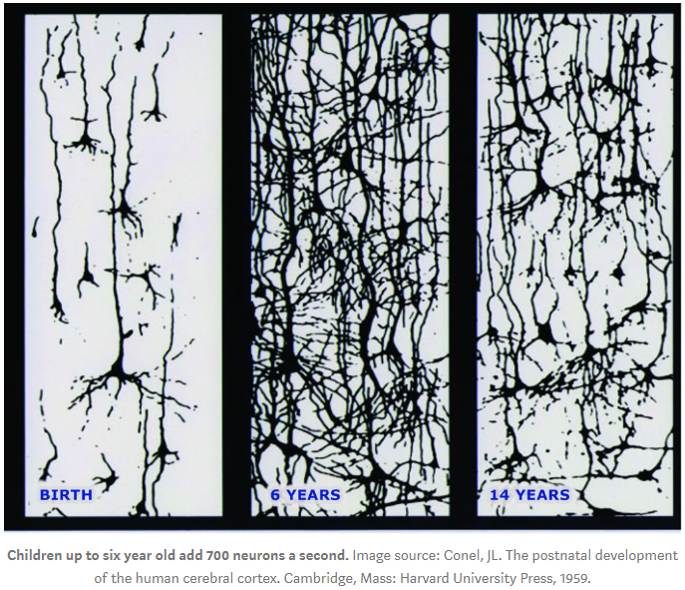
Growth of Biological Neural Networks

Slide 4
References
[1] https://medium.com/iec-partners/the-new-state-of-early-childhood-development-aa41e94e98d2

Slide 5
Thanks

